Slide 1


The Future of Healthcare: Innovations in Data to Achieve Health Equity
UCI Beall Applied Innovation
November 10, 2022

Slide 2

What is social progress?

Slide 3

Who’s adopted
The Social Progress Index?
COMPLETED/ONGOING ENGAGEMENTS
California Counties Partner: California Forward
San Jose, CA Partner: City of San Jose
San Mateo County, CA Partner: San Mateo County
Fresno, CA Partner: Heron Foundation
Orange County, CA Partner: AdvanceOC & OC Health Care Agency
Jackson, MS Partner: City of Jackson
Miami-Dade, FL Partner: Miami-Dade County
Philadelphia, PA Partner: Economic League of Greater Philadelphia
National League of Cities

Slide 4
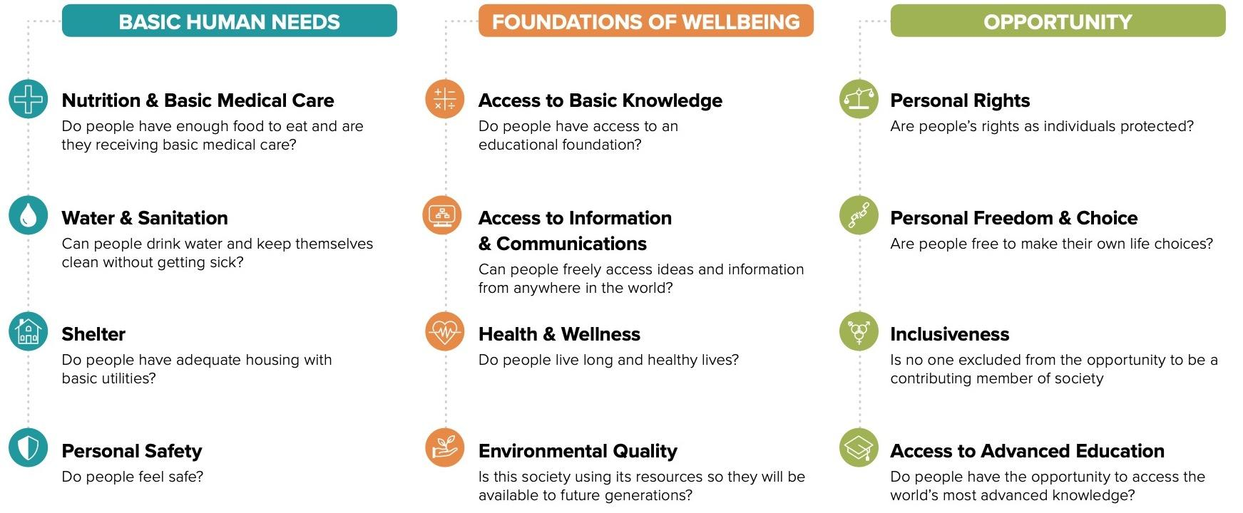
Why Do We Care?

Slide 5


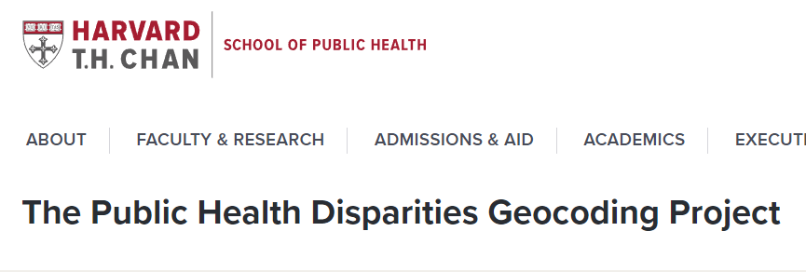
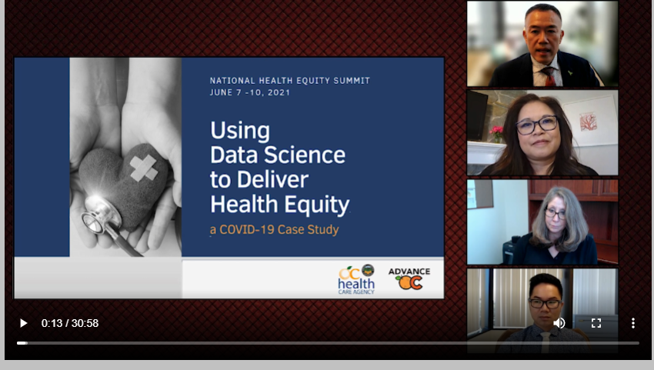


Who else cares?

Slide 6
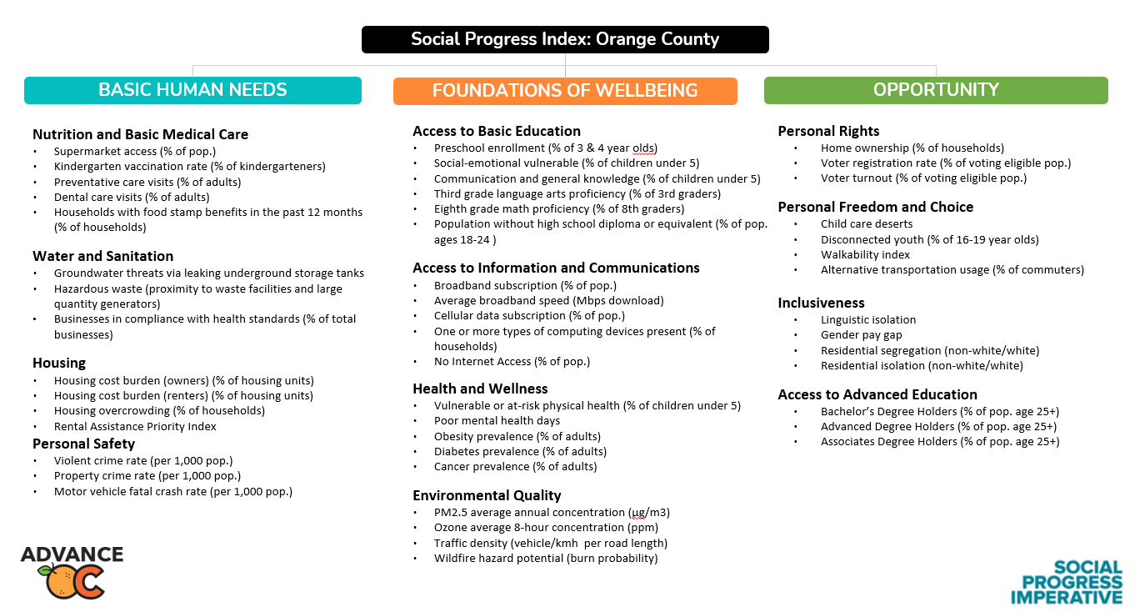

Slide 7
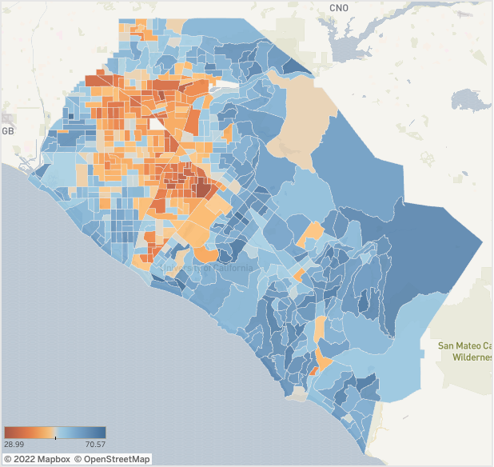
Orange County Equity Map 2.0
Measures 50 indicators in 580 census tracts, aggregating the conditions for social progress in each community across the county.
Starting point for investigating of regional, municipal, and community successes and challenges.
SPI framework encourages a methodical drill down by topic and geography.

Slide 8
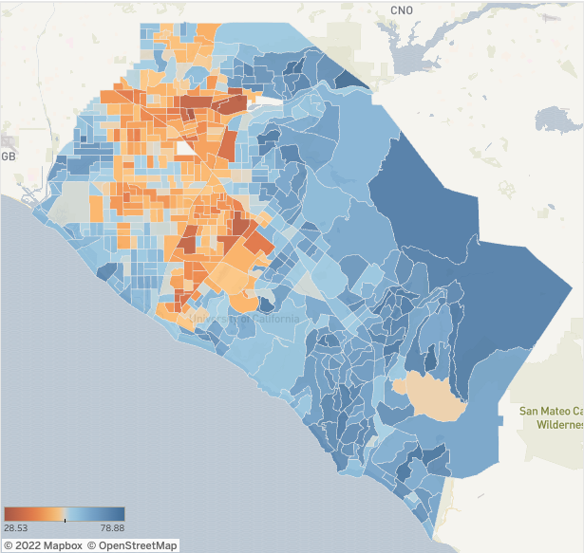
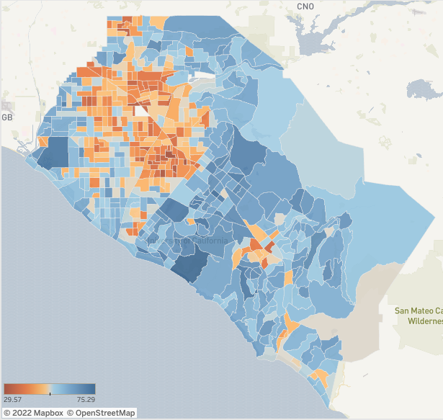
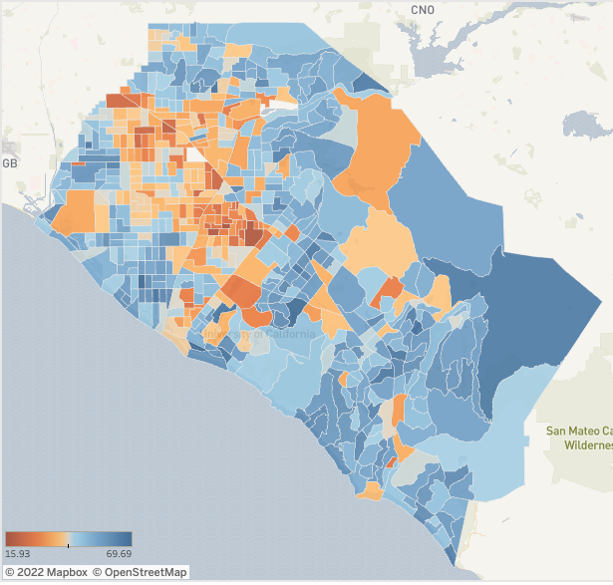


Drilling down to 3 main Dimensions…
Basic Human Needs
Foundations of Wellbeing
Opportunity

Slide 9
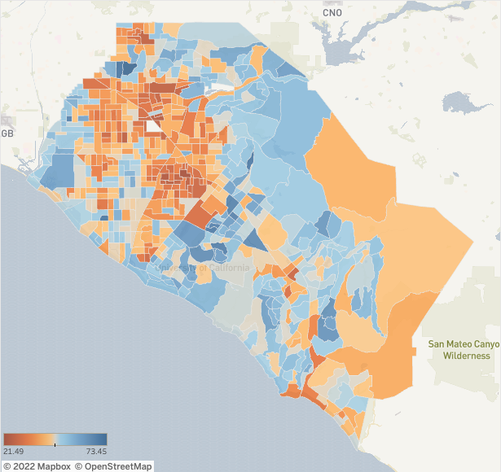
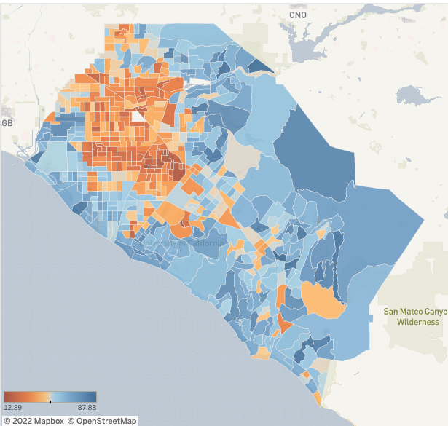
…and further into the 12 core Components
Health and Wellness
Housing

Slide 10
Top 50 Census Tracts
Census Tract | SPI Score | City/Cities
6059021810 | 64.98 | PLACENTIA, YORBA LINDA
6059021823 | 64.93 | YORBA LINDA
6059032041 | 64.91 | LAKE FOREST, ORANGE CO
6059052520 | 64.89 | IRVINE
6059110011 | 64.84 | CYPRESS, GARDEN GROVE, STANTON
6059052511 | 64.76 | IRVINE
6059042319 | 64.67 | LAGUNA NIGUEL
6059063009 | 64.66 | COSTA MESA, NEWPORT BEACH
6059052415 | 64.44 | LAKE FOREST
6059032046 | 64.39 | ORANGE CO
6059063006 | 64.37 | NEWPORT BEACH
6059032036 | 64.35 | MISSION VIEJO
6059052522 | 64.30 | IRVINE
6059032035 | 64.18 | MISSION VIEJO
6059042305 | 64.05 | DANA POINT, LAGUNA BEACH
6059042337 | 64.05 | DANA POINT, LAGUNA NIGUEL
6059032003 | 64.04 | MISSION VIEJO
6059062635 | 63.97 | ALISO VIEJO, LAGUNA WOODS
6059099237 | 63.90 | HUNTINGTON BEACH
6059075809 | 63.75 | ORANGE, VILLA PARK
6059032042 | 63.67 | ORANGE CO, RANCHO SANTA MARGARITA
6059099504 | 63.62 | SEAL BEACH
6059052434 | 63.58 | IRVINE, TUSTIN
6059052419 | 63.56 | IRVINE, ORANGE, ORANGE CO, TUSTIN
6059052533 | 63.53 | IRVINE
6059110006 | 63.50 | LOS ALAMITOS, ORANGE CO
Census Tract | SPI Score | City/Cities
6059110118 | 70.57 | CYPRESS
6059052528 | 69.54 | IRVINE
6059062701 | 69.38 | NEWPORT BEACH
6059062900 | 69.06 | NEWPORT BEACH
6059062629 | 68.80 | IRVINE
6059032045 | 67.99 | ORANGE CO
6059052506 | 67.64 | IRVINE
6059021828 | 67.58 | ORANGE CO, YORBA LINDA
6059032062 | 67.46 | ORANGE CO, SAN CLEMENTE
6059052436 | 67.00 | IRVINE
6059032038 | 66.97 | MISSION VIEJO, ORANGE CO
6059062631 | 66.93 | IRVINE
6059032031 | 66.82 | MISSION VIEJO
6059062630 | 66.80 | IRVINE
6059042336 | 66.50 | LAGUNA NIGUEL
6059042317 | 66.20 | DANA POINT, LAGUNA NIGUEL
6059062633 | 65.84 | ALISO VIEJO, LAGUNA BEACH, LAGUNA NIGUEL
6059042328 | 65.79 | LAGUNA HILLS, MISSION VIEJO
6059042111 | 65.69 | ORANGE CO, SAN CLEMENTE
6059021824 | 65.56 | YORBA LINDA
6059032040 | 65.38 | MISSION VIEJO
6059032034 | 65.30 | MISSION VIEJO, RANCHO SANTA MARGARITA
6059052431 | 65.27 | IRVINE
6059021830 | 65.09 | YORBA LINDA

Slide 11
Bottom 50 Census Tracts
Census Tract | SPI Score | City/Cities
6059087405 | 35.64 | ANAHEIM
6059087106 | 35.69 | ANAHEIM
6059086601 | 35.75 | ANAHEIM, FULLERTON
6059075517 | 35.75 | SANTA ANA, TUSTIN
6059086903 | 35.90 | ANAHEIM
6059075202 | 35.95 | SANTA ANA
6059087001 | 36.06 | ANAHEIM
6059086702 | 36.11 | ANAHEIM
6059086901 | 36.21 | ANAHEIM
6059074300 | 36.26 | SANTA ANA
6059063808 | 36.35 | COSTA MESA
6059089104 | 36.48 | GARDEN GROVE, SANTA ANA
6059074801 | 36.51 | SANTA ANA
6059063701 | 36.73 | COSTA MESA
6059074200 | 36.94 | SANTA ANA
6059076103 | 36.95 | ANAHEIM, GARDEN GROVE
6059074106 | 37.10 | COSTA MESA, ORANGE CO
6059099249 | 37.11 | SANTA ANA
6059086803 | 37.11 | ANAHEIM, BUENA PARK
6059089106 | 37.25 | GARDEN GROVE
6059074602 | 37.64 | SANTA ANA
6059087505 | 37.67 | ANAHEIM
6059110606 | 37.72 | BUENA PARK
6059074802 | 37.75 | SANTA ANA
6059001801 | 37.78 | BUENA PARK, FULLERTON
6059086501 | 38.13 | ANAHEIM, FULLERTON
Census Tract | SPI Score | City/Cities
6059980000 | 14.59 | ANAHEIM
6059021813 | 28.07 | ANAHEIM, PLACENTIA
6059074403 | 28.99 | SANTA ANA, TUSTIN
6059086502 | 30.22 | ANAHEIM
6059074902 | 31.42 | SANTA ANA
6059074502 | 31.47 | SANTA ANA
6059074701 | 31.55 | SANTA ANA
6059011720 | 32.19 | ANAHEIM, PLACENTIA
6059074901 | 32.27 | SANTA ANA
6059074805 | 32.35 | SANTA ANA
6059074407 | 33.19 | SANTA ANA, TUSTIN
6059075002 | 33.48 | SANTA ANA
6059075003 | 34.08 | SANTA ANA
6059110603 | 34.20 | BUENA PARK, FULLERTON
6059074501 | 34.34 | SANTA ANA
6059110500 | 34.72 | BUENA PARK, FULLERTON
6059074806 | 34.95 | SANTA ANA
6059075004 | 35.13 | SANTA ANA
6059087102 | 35.27 | ANAHEIM
6059087504 | 35.35 | ANAHEIM
6059074406 | 35.39 | SANTA ANA, TUSTIN
6059087403 | 35.43 | ANAHEIM
6059076102 | 35.48 | ANAHEIM, GARDEN GROVE
6059011602 | 35.63 | ANAHEIM, FULLERTON

Slide 12
Measuring Cities of
Orange County

Slide 13
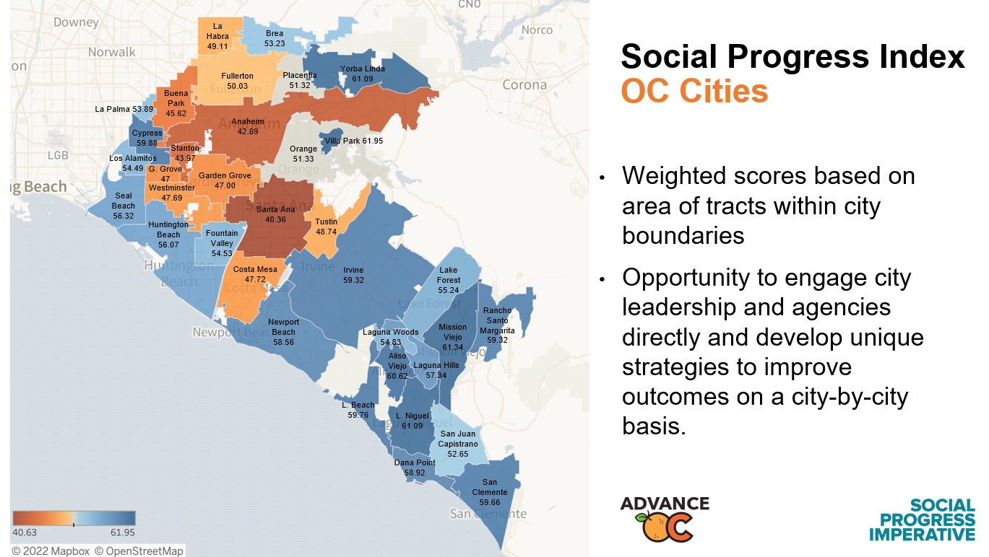

Slide 14
Cities of Orange County Social Progress Index Scores
City | SPI
VILLA PARK | 62
MISSION VIEJO | 61
LAGUNA NIGUEL | 61
YORBA LINDA | 61
ALISO VIEJO | 61
CYPRESS | 60
LAGUNA BEACH | 60
SAN CLEMENTE | 60
IRVINE | 59
RANCHO SANTA MARGARITA | 59
DANA POINT | 59
NEWPORT BEACH | 59
City | SPI
LAGUNA HILLS | 57
SEAL BEACH | 56
HUNTINGTON BEACH | 56
LAKE FOREST | 55
LAGUNA WOODS | 55
FOUNTAIN VALLEY | 55
LOS ALAMITOS | 54
LA PALMA | 54
BREA | 53
SAN JUAN CAPISTRANO | 53
ORANGE | 51
PLACENTIA | 51
City | SPI
FULLERTON | 50
LA HABRA | 49
TUSTIN | 49
COSTA MESA | 48
WESTMINSTER | 48
GARDEN GROVE | 47
BUENA PARK | 46
STANTON | 44
ANAHEIM | 43
SANTA ANA | 41

Slide 15
Examining Zip Codes

Slide 16
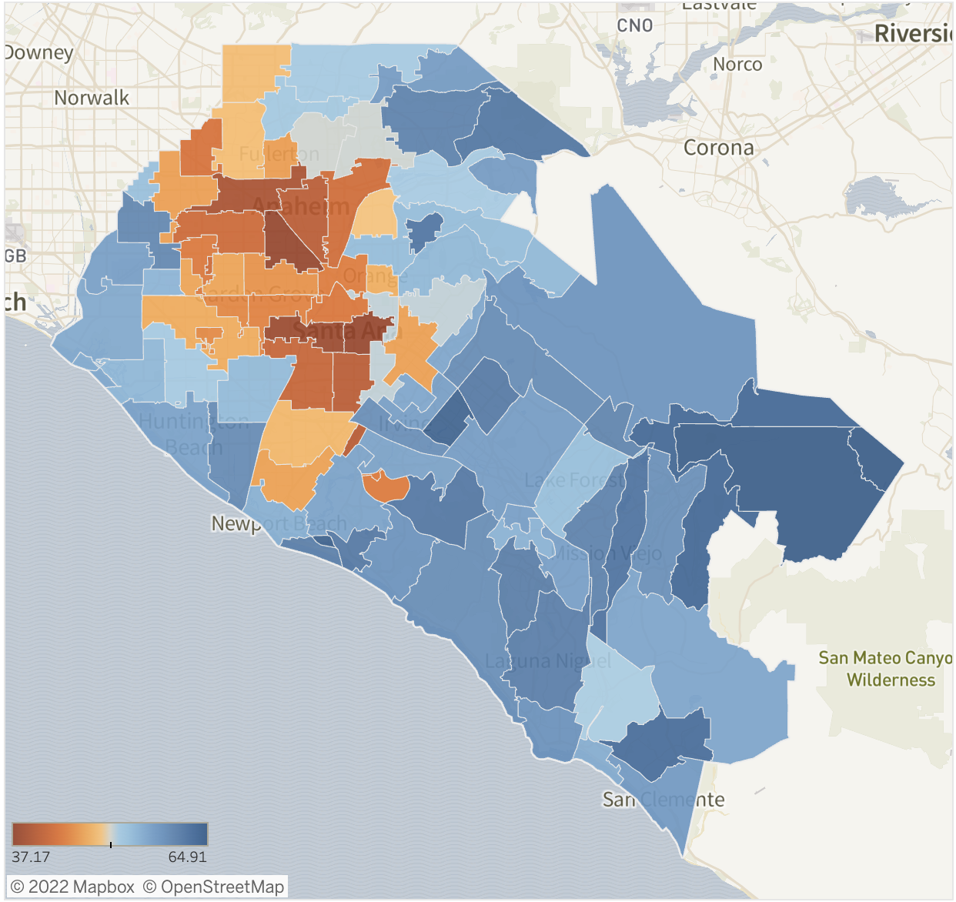
Social Progress Index
OC Cities
Weighted scores based on area of tracts within zip code boundaries

Slide 17


What Worked in Public Health
A COVID-19 Case Study in Orange County, California

Slide 18
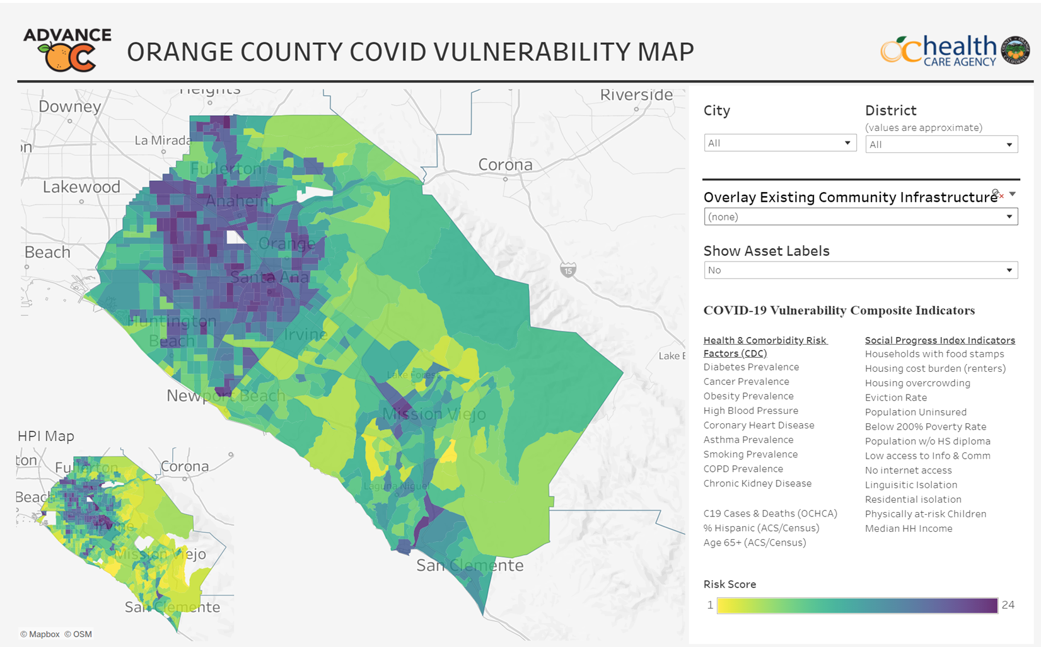

Slide 19

Building on Truth & Trust
Equity in OC: A 2-Year Case Study in Building Truth and Trust

Slide 20
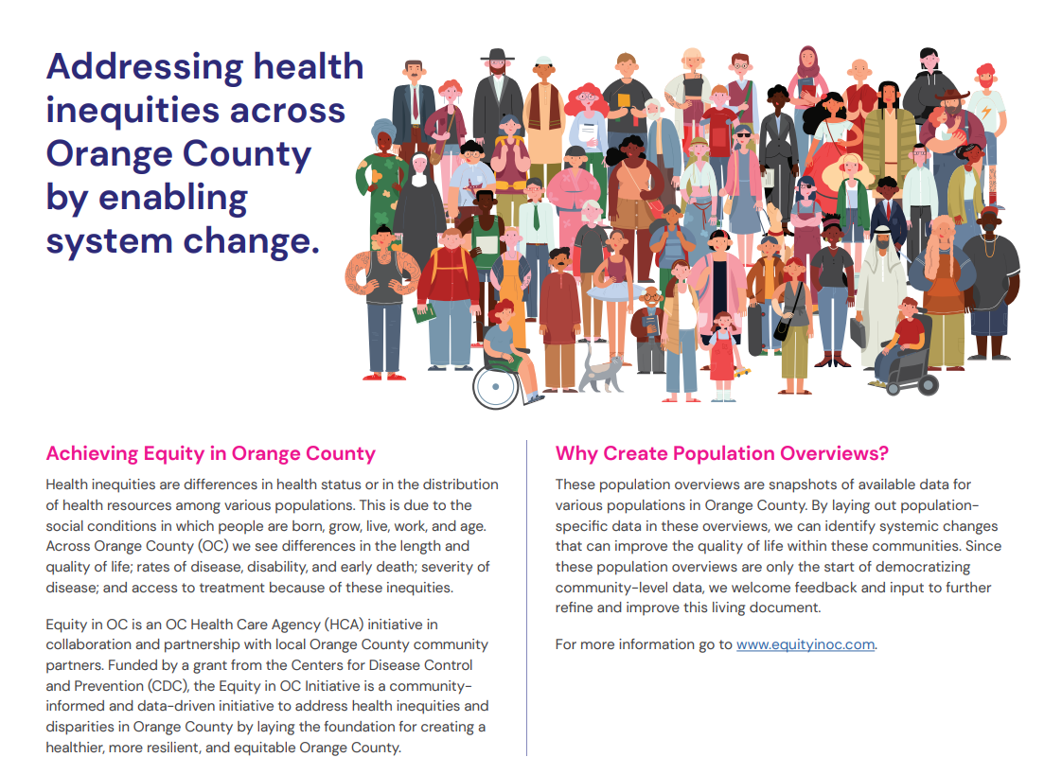

Slide 21
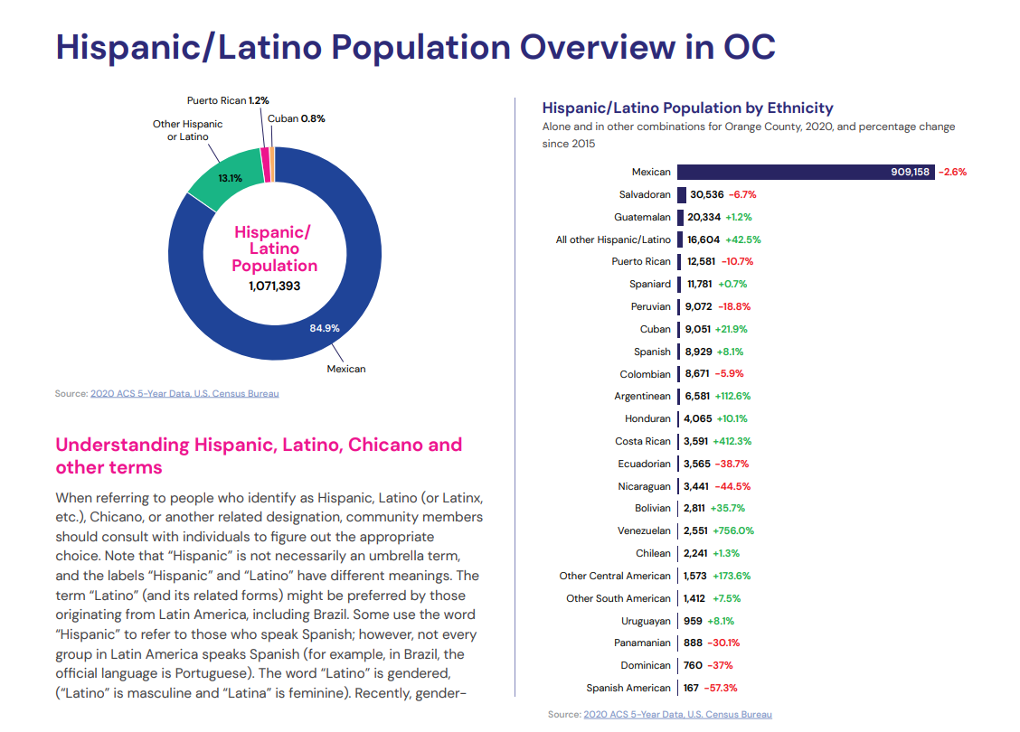

Slide 22
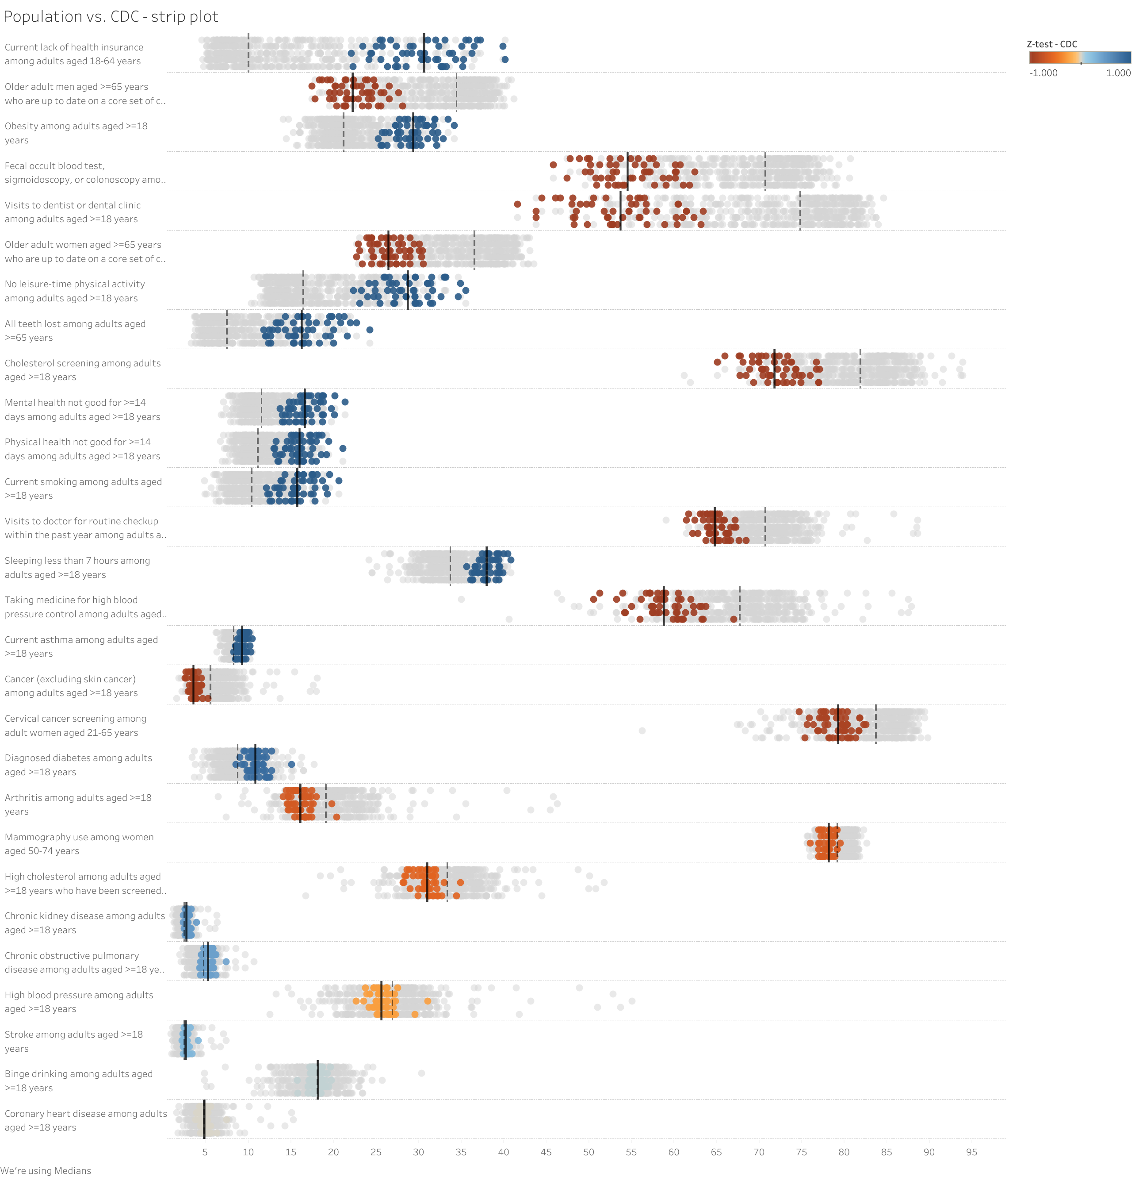
Query: Show me the census tracts > 75% Hispanic/Latino
County median = 10%
Population median = 30.7%
Population = 22.4% County = 34.5%
Population = 29.4% County = 21.2%
Population = 54.5% County = 70.7%
Population = 53.7% County = 74.8%

Slide 23
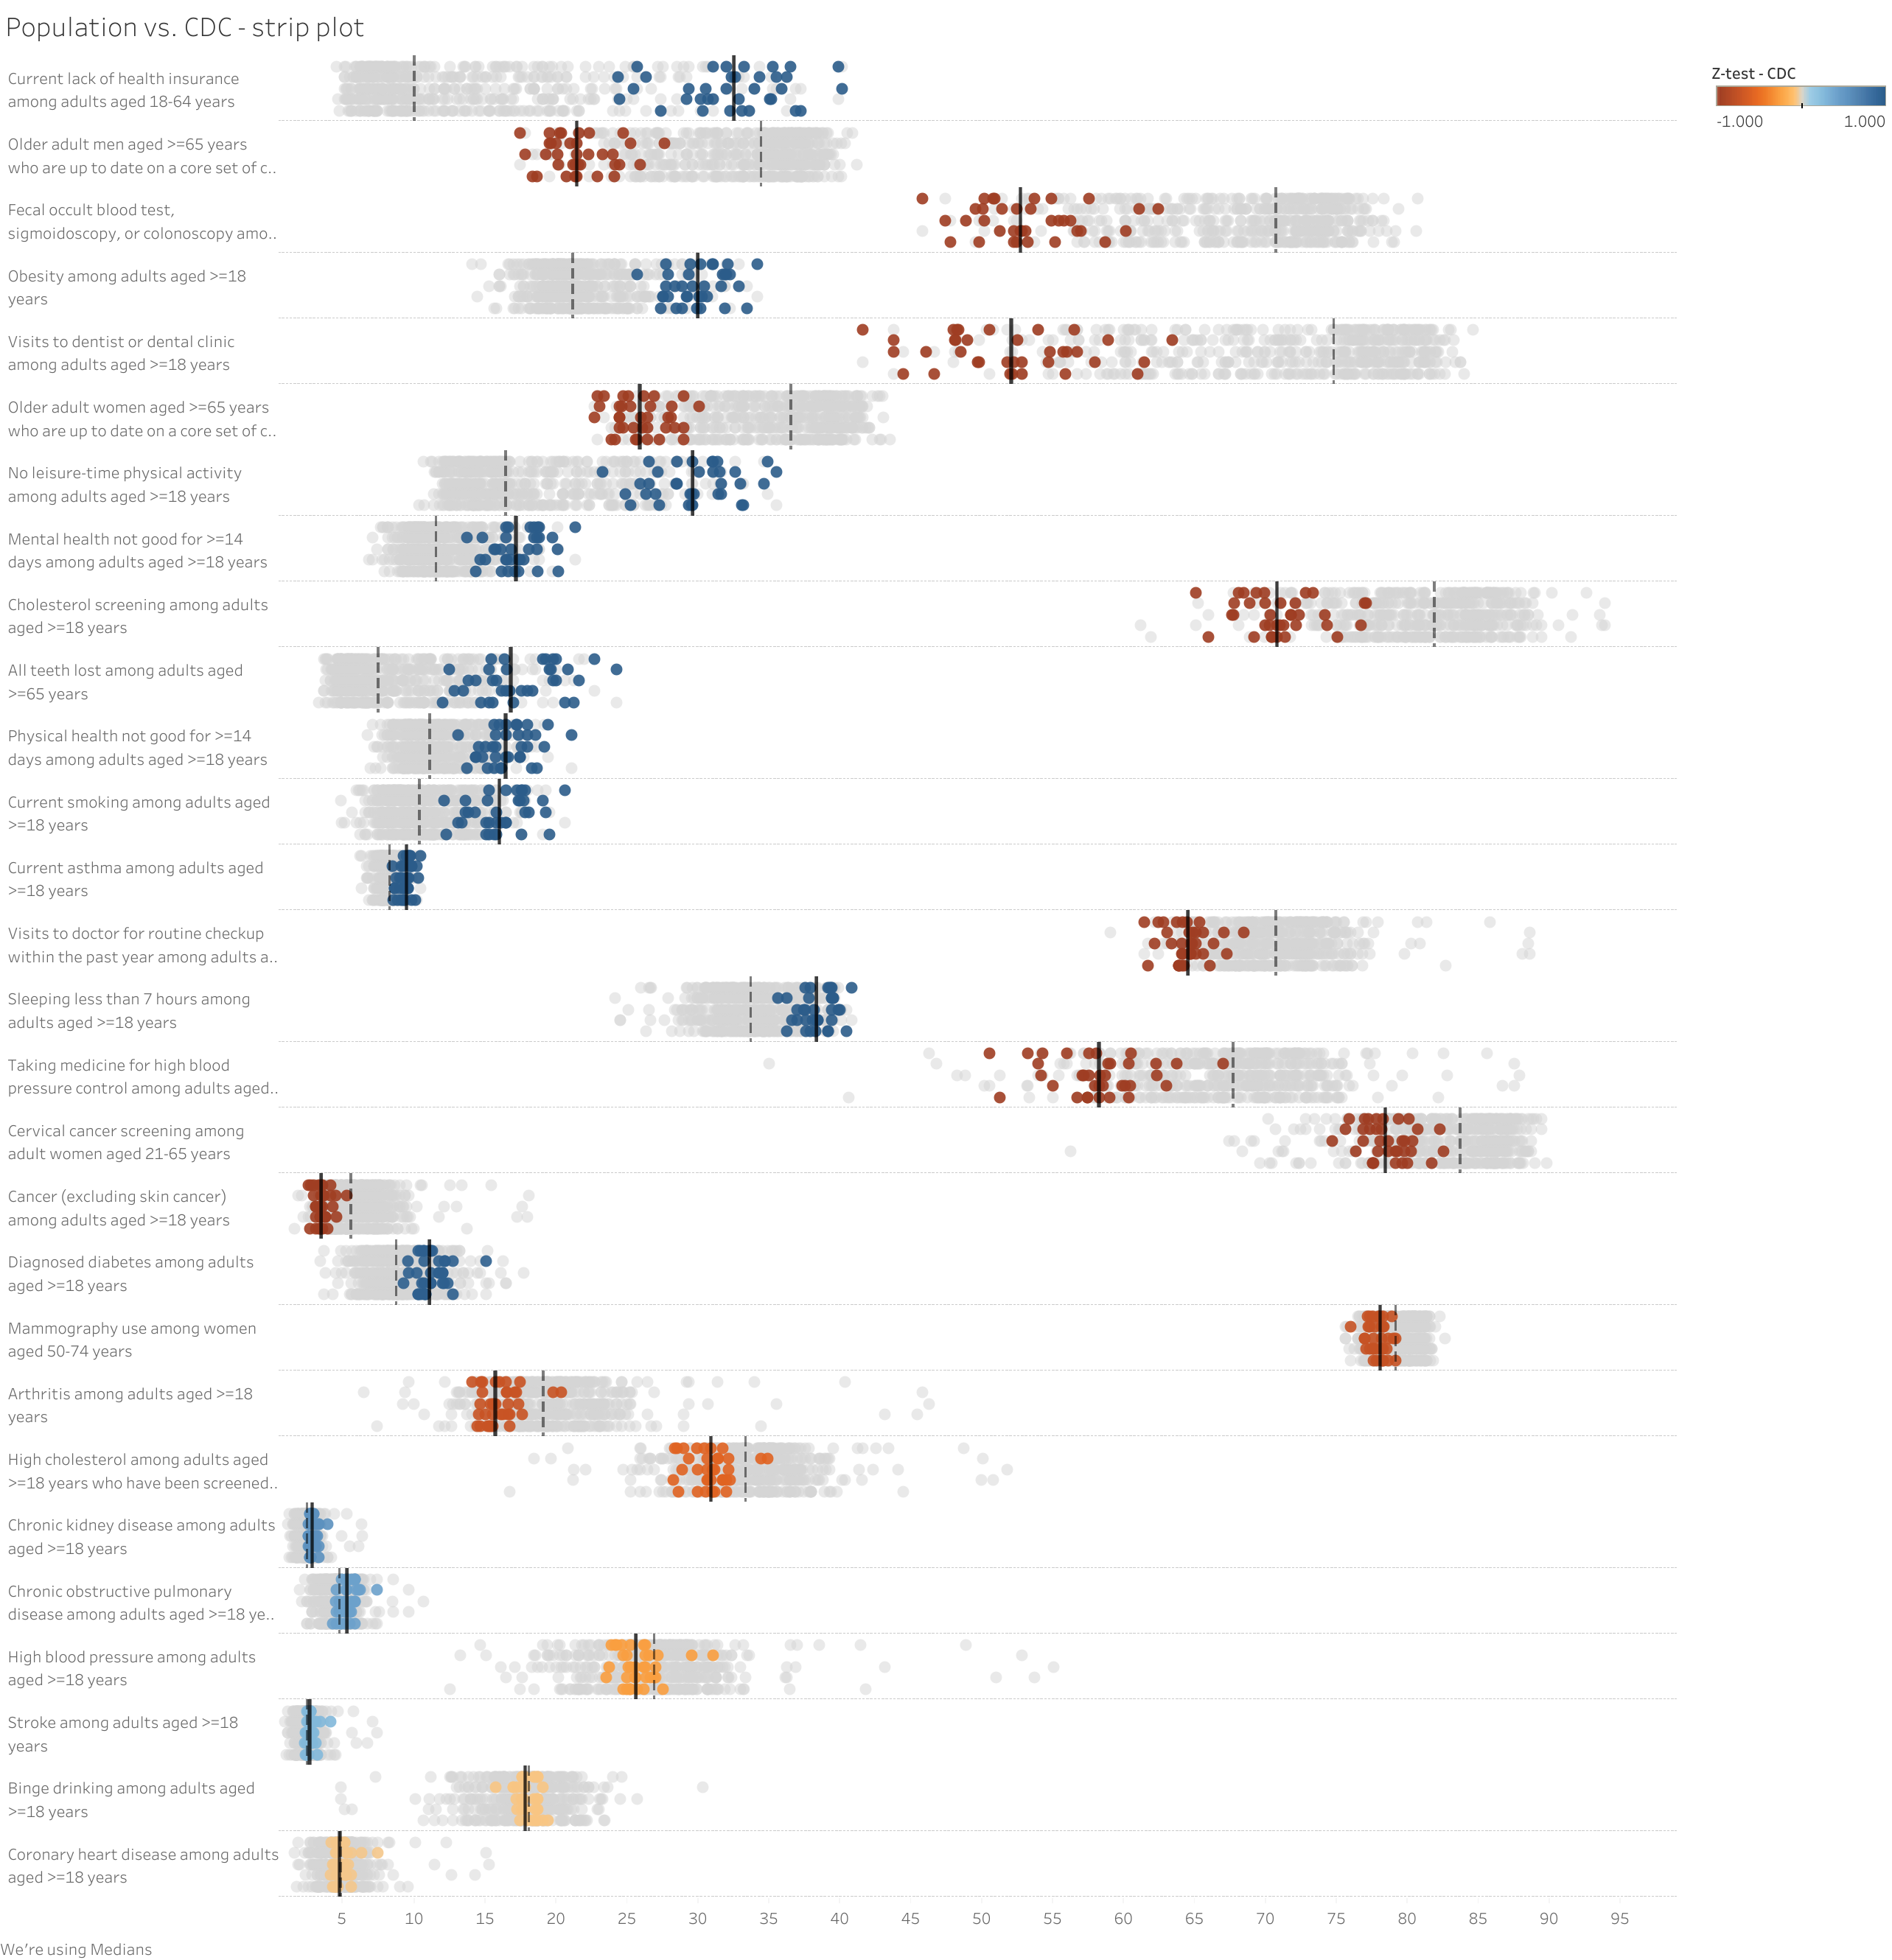
Query: Show me the census tracts > 75% Hispanic/Latino: Mexicans
Population = 32.5% County = 10%
Population = 34.4% County = 21.4%
Population = 52.7% County = 70.7%
Population = 30% County = 21.2%
Population = 52.1% County = 74.8%
Population = 25.9% County = 36.6%

Slide 24
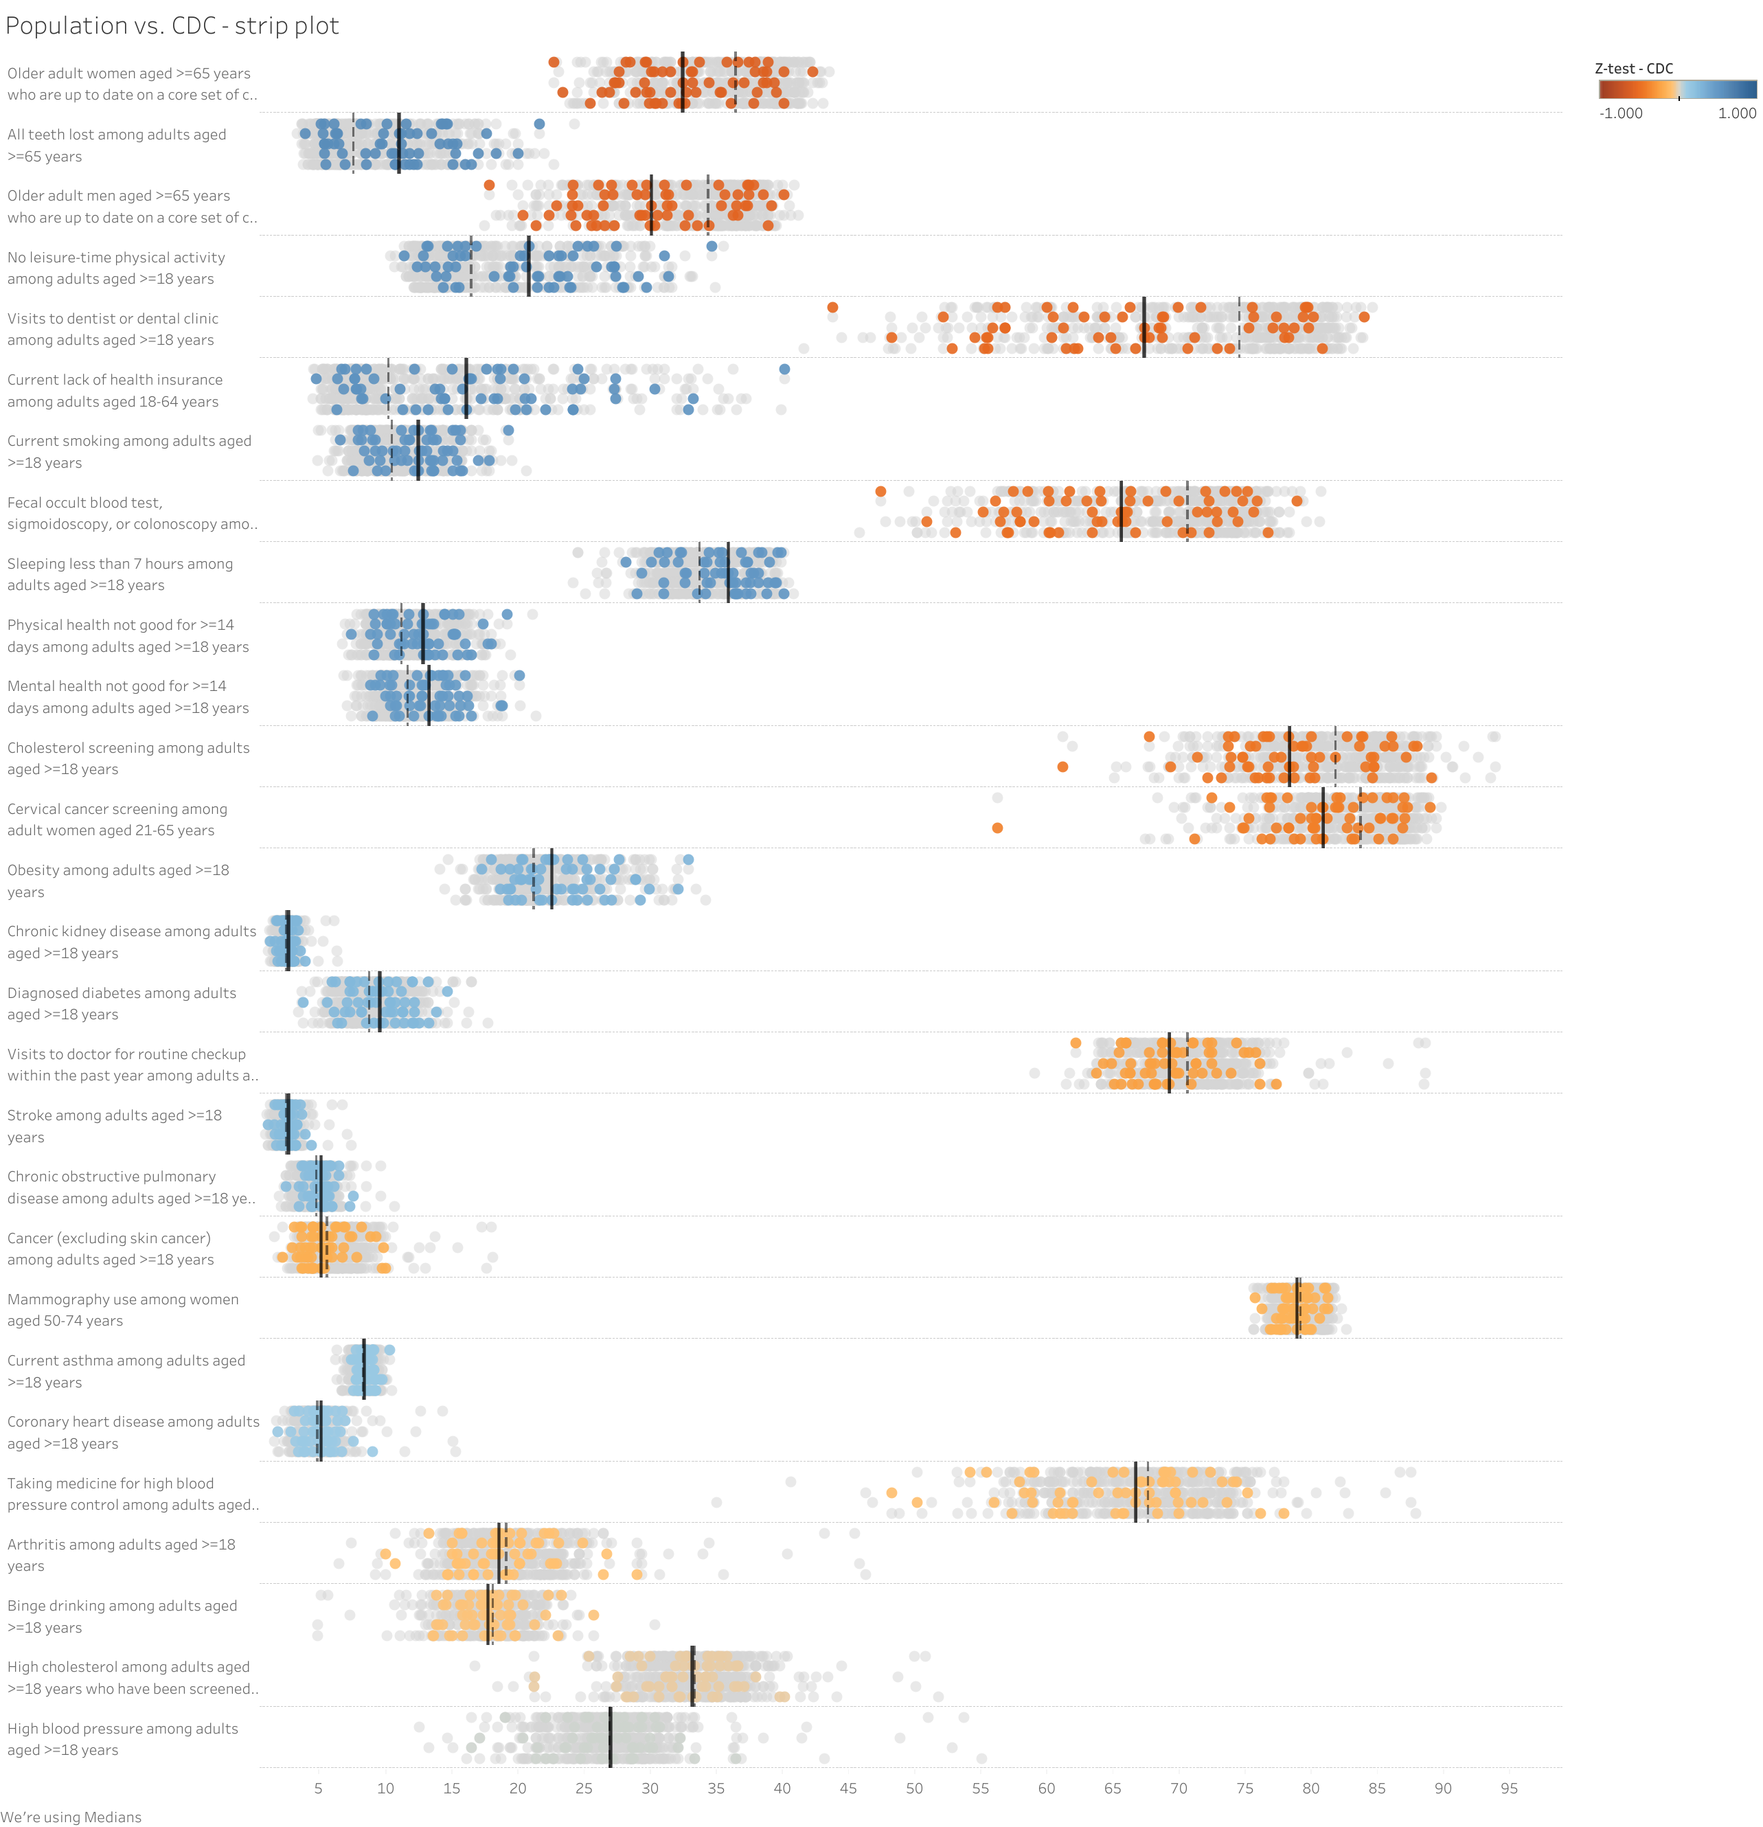
Query: Show me the census tracts with the Lowest Preschool Enrollment

Slide 25
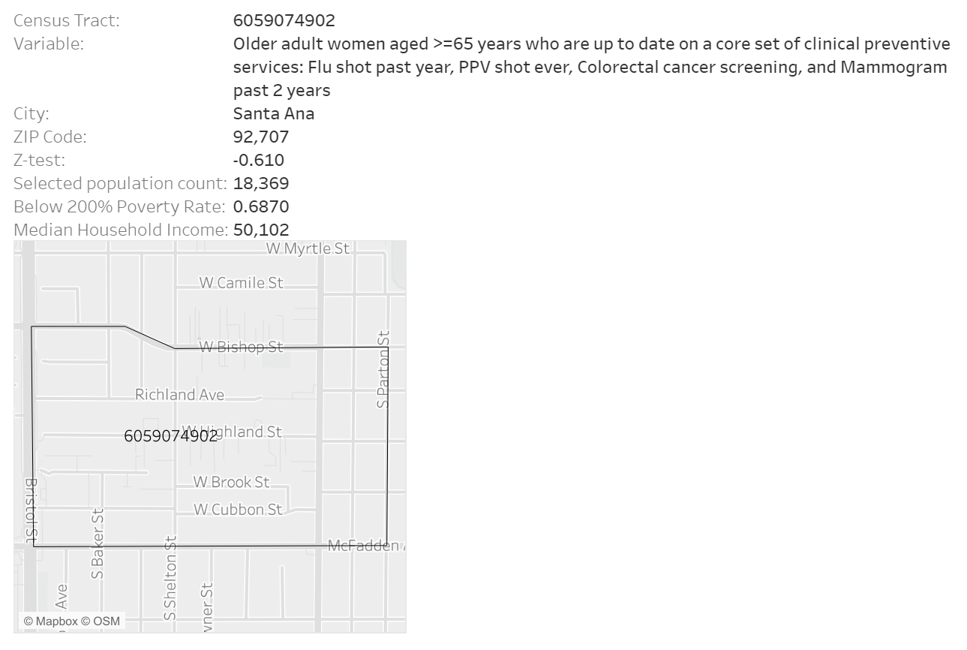
Query: Show me the census tracts with the Lowest Preschool Enrollment

Slide 26
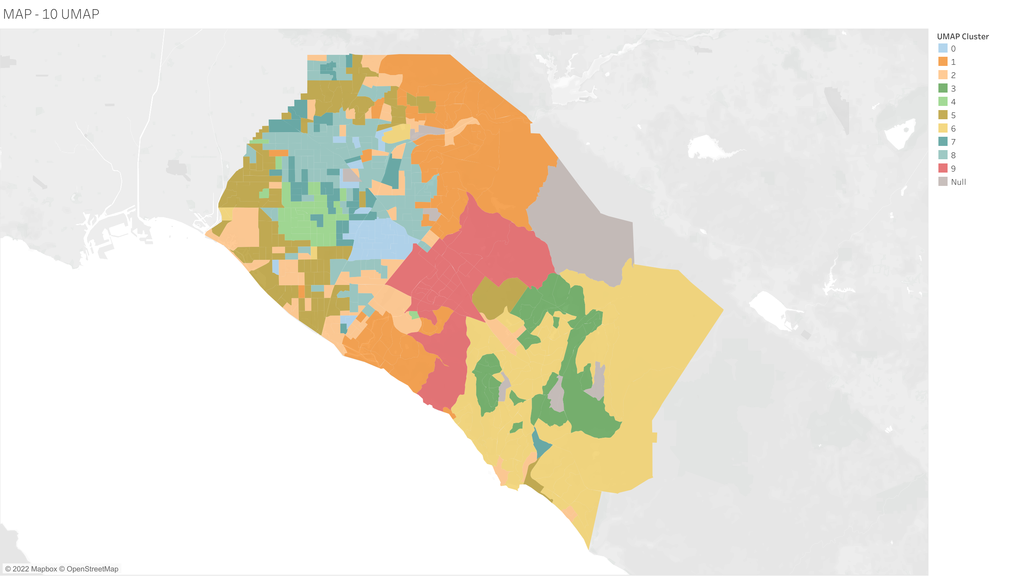
Query: Which Neighborhoods Have Similar SPI Characteristics?
By diagnosing neighborhoods, we can see the real boundaries of health and wellness in our communities.
Clustering census tracts according to shared Social Progress Index characteristics can help determine how neighborhoods will react to different policy interventions.

