Slide 1

INNOVATIONS IN MENTAL HEALTH
The Future of Healthcare: Innovations in Data to Achieve Health Equity
Notes:
Data is an important and critical element in addressing health equity. When data is absent, entire populations are overlooked. When clinical trials omit people of color, medicine is not inclusive, precise, or adequate. Historically marginalized communities are victimized by data inequity and it has a ripple effect that can take generations to correct.
This symposium will tackle data equity as a foundational component of health equity. We will hear speakers from the public and private sector to an audience of medical practitioners, scientists, researchers, community organizations, patient advocates, students, and the community at large. We will also have breakout sessions featuring 4 different sectors of healthcare including mental health, precision health (physical health), public health and prevention/ early intervention

Slide 2
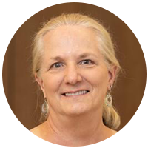
WELCOME
MODERATOR:
DR. KAREN LINKINS, CHIEF STRATEGIST AT MIND OC
Karen W. Linkins, Ph.D. specializes in systems transformation in the health, behavioral health, and human services fields through strategic planning, organizational development, community engagement, evaluation and quality improvement. Her approach is to advance integrated care by promoting cross-sector accountability among policy makers, funders, and providers to improve health outcomes through delivery system redesign, payment reform, care coordination, and data sharing. Dr. Linkins has worked in the area of integrated systems and care for over 20 years and is a recognized leader in integrated behavioral health nationally, she has led more than 70 research, evaluation, technical assistance, and strategic planning projects for Federal agencies, states, philanthropic organizations, and community-based organizations and clinics. Dr. Linkins earned her PhD in Medical Sociology at the University of California, San Francisco and an undergraduate degree from Smith College.

Slide 3
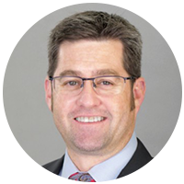
MARSHALL MONCRIEF, LCSW, MBA
CEO of MIND OC
Marshall Moncrief leads Be Well OC, a community-wide cross-sector coalition creating tomorrow’s mental health care system. He also serves as a commissioner for the Orange County Commission to End Homelessness. Marshall is a licensed psychotherapist and holds an executive MBA in healthcare management. For more than 15 years prior to his current role with Mind OC, Marshall served as the executive clinical and administrative leader of mental health and addiction services for the Hoag Health and Providence-St Joseph Health Systems (PSJH). In this prior role, Marshall developed the Institute for Mental Health and Wellness for PSJH Southern California, overseeing hospital and primary/specialty care services across LA, Orange County and the High Desert. He created California’s first residential addiction treatment program co-located with an acute-care hospital, and co-founded the ASPIRE consortium, which scaled across 4 independent health systems a unique treatment program for adolescents and their families. Marshall has enjoyed direct clinical work in private practice, as well as teaching for local colleges and universities.
Notes:
Data is an important and critical element in addressing health equity. When data is absent, entire populations are overlooked. When clinical trials omit people of color, medicine is not inclusive, precise, or adequate. Historically marginalized communities are victimized by data inequity and it has a ripple effect that can take generations to correct.
This symposium will tackle data equity as a foundational component of health equity. We will hear speakers from the public and private sector to an audience of medical practitioners, scientists, researchers, community organizations, patient advocates, students, and the community at large. We will also have breakout sessions featuring 4 different sectors of healthcare including mental health, precision health (physical health), public health and prevention/ early intervention

Slide 4

Mission
Optimal Mental Health and Wellness for All Orange County Residents
Vision
Build Orange County’s World-Class Mental Health System
Today

Slide 5
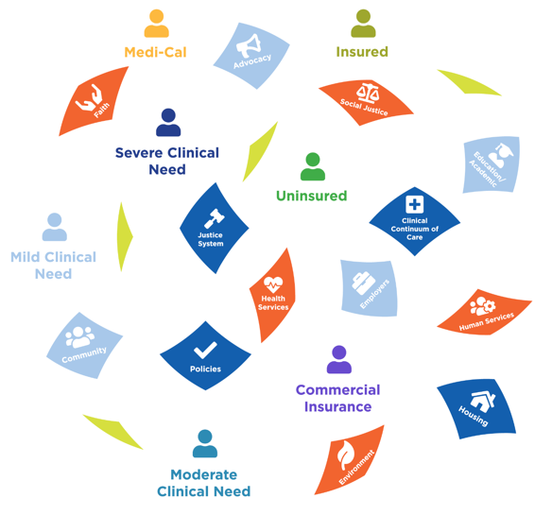




The Problem
Fragmentation and silos leave many residents unserved, underserved, and inappropriately served.
    Increased crises
    Law enforcement and EMS are default response
    Hospitals and jails are default destination

Slide 6
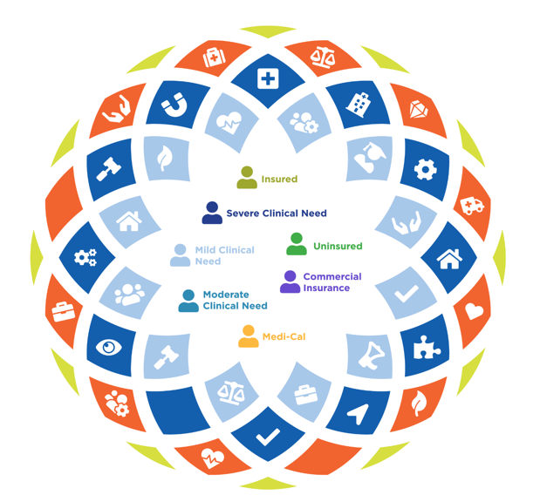


The Solution
Whole Community Movement to create a Unified System for All .

Slide 7
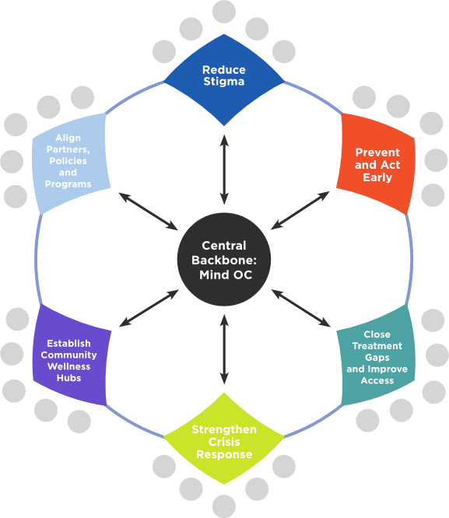
Blueprint for Aligned Action
BE WELL COALITION
400+ Organizations & 1.7k Individuals
KEY SPECIAL INITIATIVES
Addressing The System Gaps,
Building Trust and Connection
Children’s Trauma Informed Network of Care
(funded by CA Surgeon General)
Community Suicide Prevention
(funded by HCA MHSA)
Addiction Coalition/Youth Opioid Treatment
(funded by CA DHCS)

Slide 8

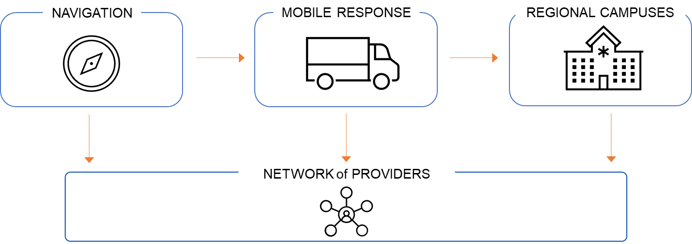

2022-2025 Focus: Build the System for All Residents
Be Well OC is not simply a new set of services, or business as usual.
The is a vital Interagency Collaboration. Alignment = Agility & Acceleration.
County
CalOptima
Hospitals
Cities
Private Stakeholders
Mind OC
NETWORK

Slide 9
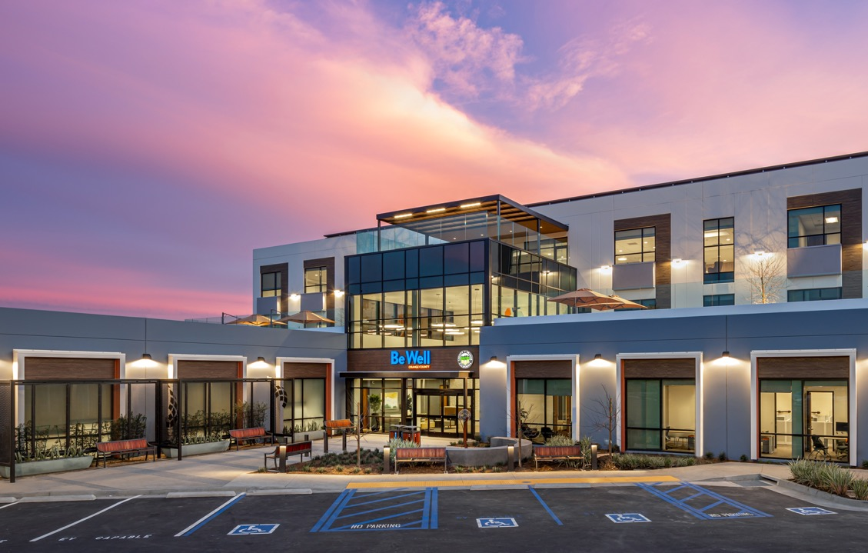
Orange Campus
Optimization
Year 1 Learning to improve the operating model
10

Slide 10










Historic Public-Private Partnership
Public-private partnership

Slide 11







WELLNESS CAMPUS GUIDING PRINCIPLES
Commitment to serve all community members regardless of payor status
A place that provides hope; a trusted support
De-stigmatizing mental health: warm, welcoming, respectful – an exceptional experience
Supporting an integrated continuum of care and seamless connections to services
The Campuses
Collaborative of public/private partners to provide new models of care
Outdoor connectivity; nature as a vital part of health & wellness

Slide 12
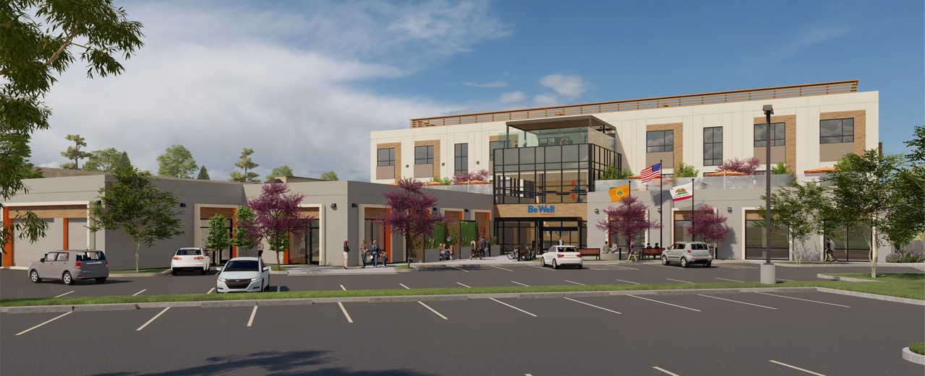
Substance Use Residential
15 beds
Withdrawal Management 12 beds
Recovery Station 12 beds
Crisis Residential 15 beds
Crisis Stabilization Unit
16 adult beds, 8 youth beds
Mental Health Residential 15 beds
Orange Campus Utilization (through March 2022)
Total | Urgent Care | Residential
Overall Admissions: 4,598 | Overall Admissions: 3,658 | Overall Admissions: 940

Slide 13


Residential living room, Orange

Slide 14

Residential rooftop desk, Orange

Slide 15


Current Model: Campuses
County contracts with service providers
Substance Use Service Provider
Mental Health Service Provider
Sobering
Center
Withdrawal
Management
Co-Occurring
Residential
SUD
Residential
CSU
Adult
CSU
Adolescent
Crisis
Residential
Each service holds a lease contract with Mind OC for each respective program space
Mind OC
Mind OC revenue from rent:
clinical/operations oversight & asset management and
11

Slide 16


Proposed Model: Campuses
MSA with Mind OC for Services and Facility
Mind OC
501C3
Mind OC provides clinical and operational management, as well as property and asset management
Mind OC subcontracts services & reports to County
for regulatory and compliance oversight
Substance Use Service Provider
Mental Health Service Provider
Sobering
Center
Withdrawal
Management
Co-Occurring
Residential
SUD
Residential
CSU
Adult
CSU
Adolescent
Crisis
Residential
Notes:
Under HCA mini org chart

Slide 17
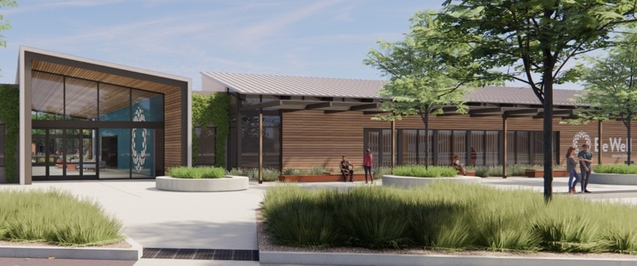
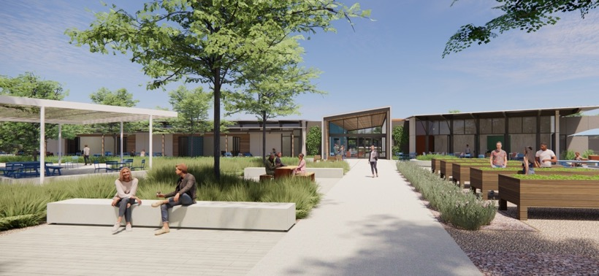
Irvine Campus
33

Slide 18
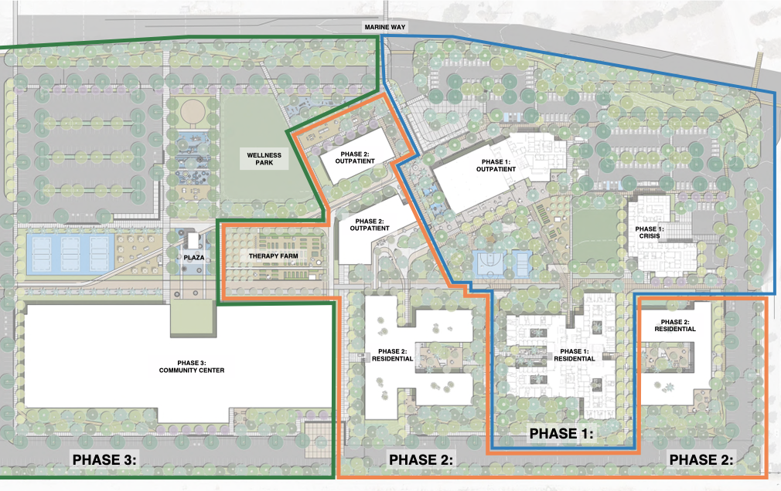
Irvine Development
Area 1
Child/Adolescent and Adult
CSU & Sobering
Residential Treatment
Outpatient Services
Area 2
Residential Specialties (Women’s Services, More Children’s)
Outpatient Services Expansion
FQHC Medical / Dental Clinic
Area 3
Education & Training
Community Meetings & Events
Youth and Senior Centers
Interfaith Shared Use Space

Slide 19



Phase 1 Site - 74,800 s.f.
Outpatient
23,500 s.f.
Urgent Care
13,900 s.f.
Residential
37,400 s.f.

Slide 20
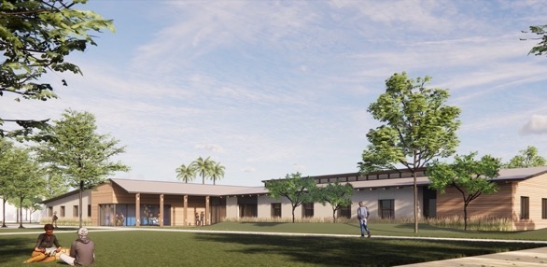
Design Aesthetic: Intimate Residential Feel, Indoor/Outdoor Experience
Welcome Center / Outpatient Services
Crisis Services
Outpatient Services / Exterior Program Space
Residential Services, Central Courtyard
Be Well OC

Slide 21

TAMEKA TATES, MA, MS, Director of Mobile Crisis Response
Tameka Tates is currently the Director of Mobile Crisis Response, Tameka has been working in the field of Social Service for the past 21 years. Tameka previously worked with people experiencing homelessness at PATH (People Assisting the Homeless) as Associate Director of Housing for 6 years and moved on to be Housing Manager for the San Diego Region with Telecare and Project Director at Equus overseeing the COVID-19 hotel program. While gaining hands on experience Tameka continued her education and went on to Chapman University to earn her MA in Organizational Leadership and her MS in Human Resources and is currently working on her Master’s in social work with the goal of earning her LCSW.
6

Slide 22

Be Well Mobile
Non-emergency support for all residents experiencing mental health & substance use related crises.
Supports law enforcement, EMS, County Response Teams & community.
Deployment at a local level improves responsiveness & Health Equity.
6

Slide 23

Be Well HOPE Mobile Response Team
The Helping Out People Everywhere (HOPE) Team is a mobile response team providing in-community assessment and stabilization of individuals experiencing substance abuse, psychological crises, and homelessness. Our team works in partnership with local law enforcement to change how we respond to those needing mental health support.

Slide 24






CAT/PERT
Outreach & Engagement
Street Medicine
Be Well Mobile
Optimizes deployment of first responders &
specialized County response teams
An Orange County Mobile Response Continuum:

Slide 25



Anaheim
Since August 2021 Be Well HOPE Mobile has launched in the following cities:
Huntington Beach August 2, 2021
Garden Grove October 6, 2021
Newport Beach February 23, 2022
Anaheim April 24, 2022
Irvine May 31, 2022

Slide 26
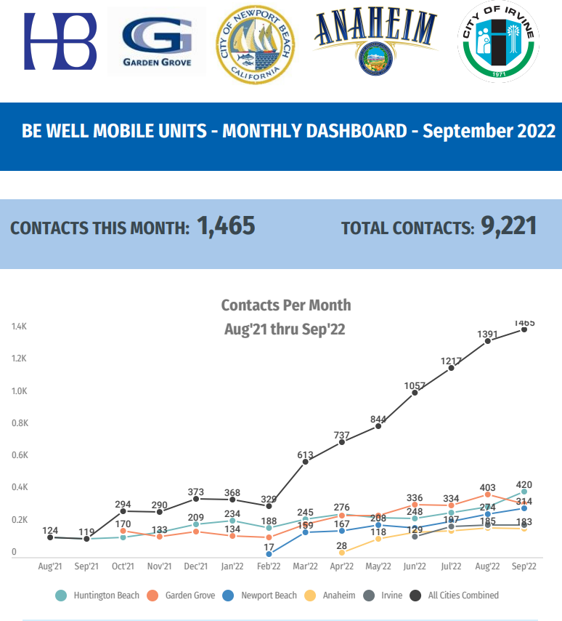

Slide 27
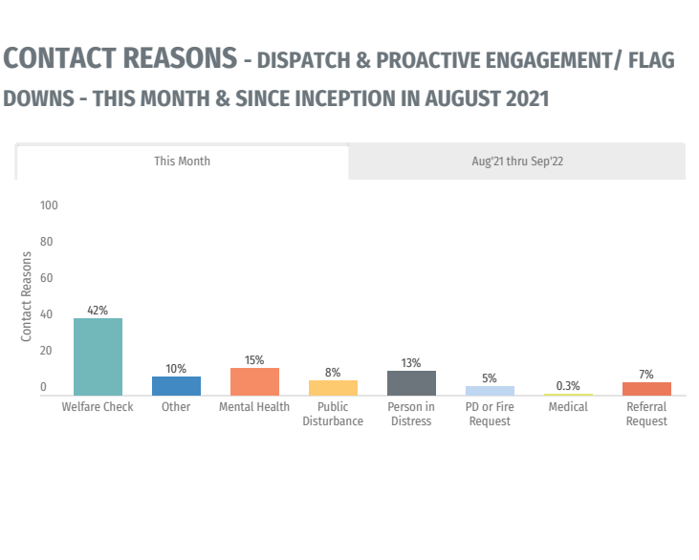

Slide 28
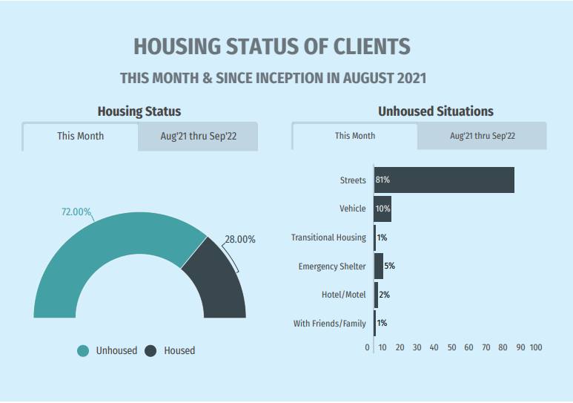

Slide 29
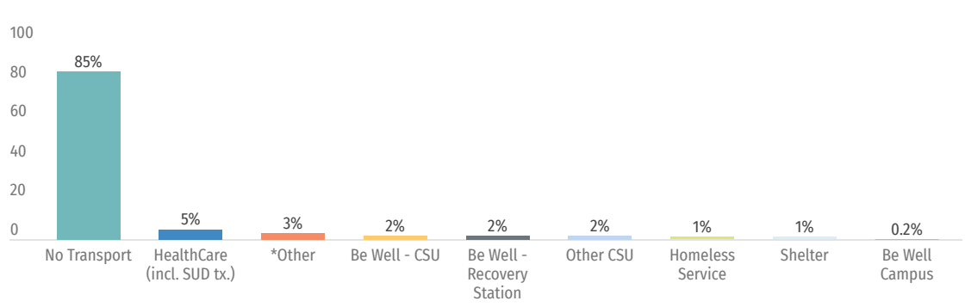
85% are stabilized in community =
Exemplifies Health Equity
Disposition of Encounters ​

Slide 30

VERONICA KELLEY, DSW, LCSW, Chief Mental Health and Recovery Services at the Orange County Health Care Agency
Veronica is a member of the Governing Board for the County Behavioral Health Directors Association of California (CBHDA), serving as the President Elect, she sits on the Executive Committee and serves as the Co-Chair for the Substance Abuse Prevention & Treatment (SAPT) Committee. She is also a Council Member to the California Behavioral Health Planning Council, Board Member to the California Mental Health Services Authority and Associate Member to the American Society of Addiction Medicine. In August of 2019 she was appointed by the governor as a member of the No Place Like Home Program Advisory Committee. Dr. Kelley is a Professor at Mount St. Marys’ University teaching in the undergraduate Social Work/Sociology/Gerontology and Film Department, an Adjunct Faculty in the Masters of Social Work Program at Loma Linda University Department of Social Work and Social Ecology, and a Contract Instructor at Cal State University, San Bernardino, teaching Social Work with Alcohol and Drug Abuse.
6

Slide 31

Orange County Health Care Agency & BeWell

Slide 32
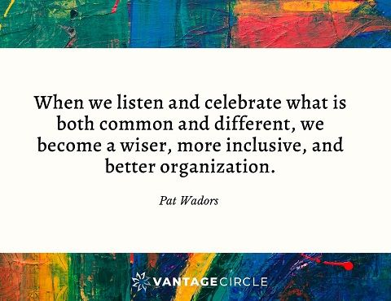
COLLABORATION
IS MORE THAN
JUST WORKING TOGETHER

Slide 33

Collaboration only works if mission remains the guiding star
COLLABORATION ONLY WORKS IF MISSION REMAINS THE GUIDING STAR

Slide 34

COLLABORATION INCLUDES REMOVING BARRIERS IN ORGANIZATIONAL CULTURE AND A CHANGE IN PERSPECTIVE

Slide 35

COLLABORATION ENCOURAGES TRANSPARENCY
Notes:
.

Slide 36

COLLABORATION INCLUDES ACCOUNTABILITY

Slide 37

CELEBRATE COLLABORATION

Slide 38
OC HCA+ CalOptima+ Mind OC+ County of Orange =

Slide 39
DATA BEING COLLECTED:
Demographics – age, gender, race, city of residence
Insurance Status and Source
Access: Referral source
Continuity of Care: Discharge Disposition and Community Referrals
Average Daily Census and Average Length of Stay
Emergency Department Utilization (reductions)
Care Navigation
Substances Used and Conditions Treated
Additional Performance Metrics and Dashboard

Slide 40
Presenter Q & A
The Future of Healthcare: Innovations in Mental Health
Notes:
Data is an important and critical element in addressing health equity. When data is absent, entire populations are overlooked. When clinical trials omit people of color, medicine is not inclusive, precise, or adequate. Historically marginalized communities are victimized by data inequity and it has a ripple effect that can take generations to correct.
This symposium will tackle data equity as a foundational component of health equity. We will hear speakers from the public and private sector to an audience of medical practitioners, scientists, researchers, community organizations, patient advocates, students, and the community at large. We will also have breakout sessions featuring 4 different sectors of healthcare including mental health, precision health (physical health), public health and prevention/ early intervention

Slide 41
Audience Table Discussion Questions
What innovative ideas do you have to address behavioral health equity?
What are some ways we can collectively use data and improve mental health outcomes?
What can we do to create a better and more integrated system of care to support the community's mental health needs?
Notes:
Data is an important and critical element in addressing health equity. When data is absent, entire populations are overlooked. When clinical trials omit people of color, medicine is not inclusive, precise, or adequate. Historically marginalized communities are victimized by data inequity and it has a ripple effect that can take generations to correct.
This symposium will tackle data equity as a foundational component of health equity. We will hear speakers from the public and private sector to an audience of medical practitioners, scientists, researchers, community organizations, patient advocates, students, and the community at large. We will also have breakout sessions featuring 4 different sectors of healthcare including mental health, precision health (physical health), public health and prevention/ early intervention

Slide 42


Thank you!
JOURNEY
Community
Health
Empathy
Belonging
Trust
Connection
FAITH
HOPE

